Slide 1
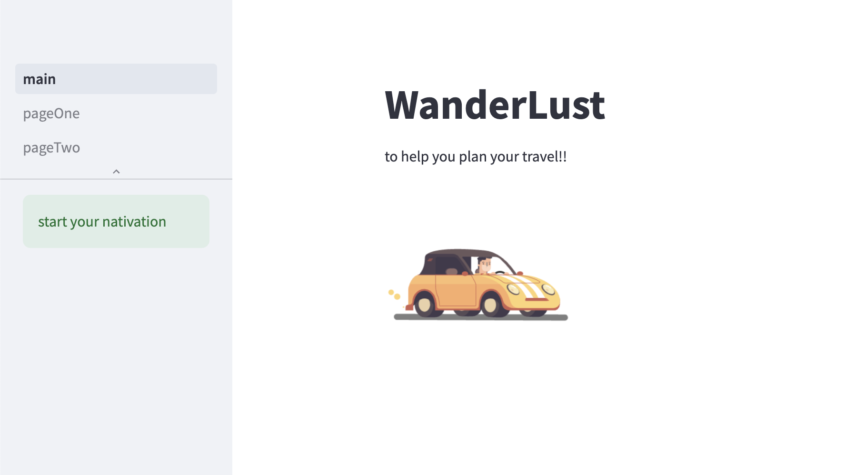
ChatGPT Assignment - Chatbot
Professor – Prof Subrata Das
Name – Soeb Hussain
Course - GenAI

Slide 2
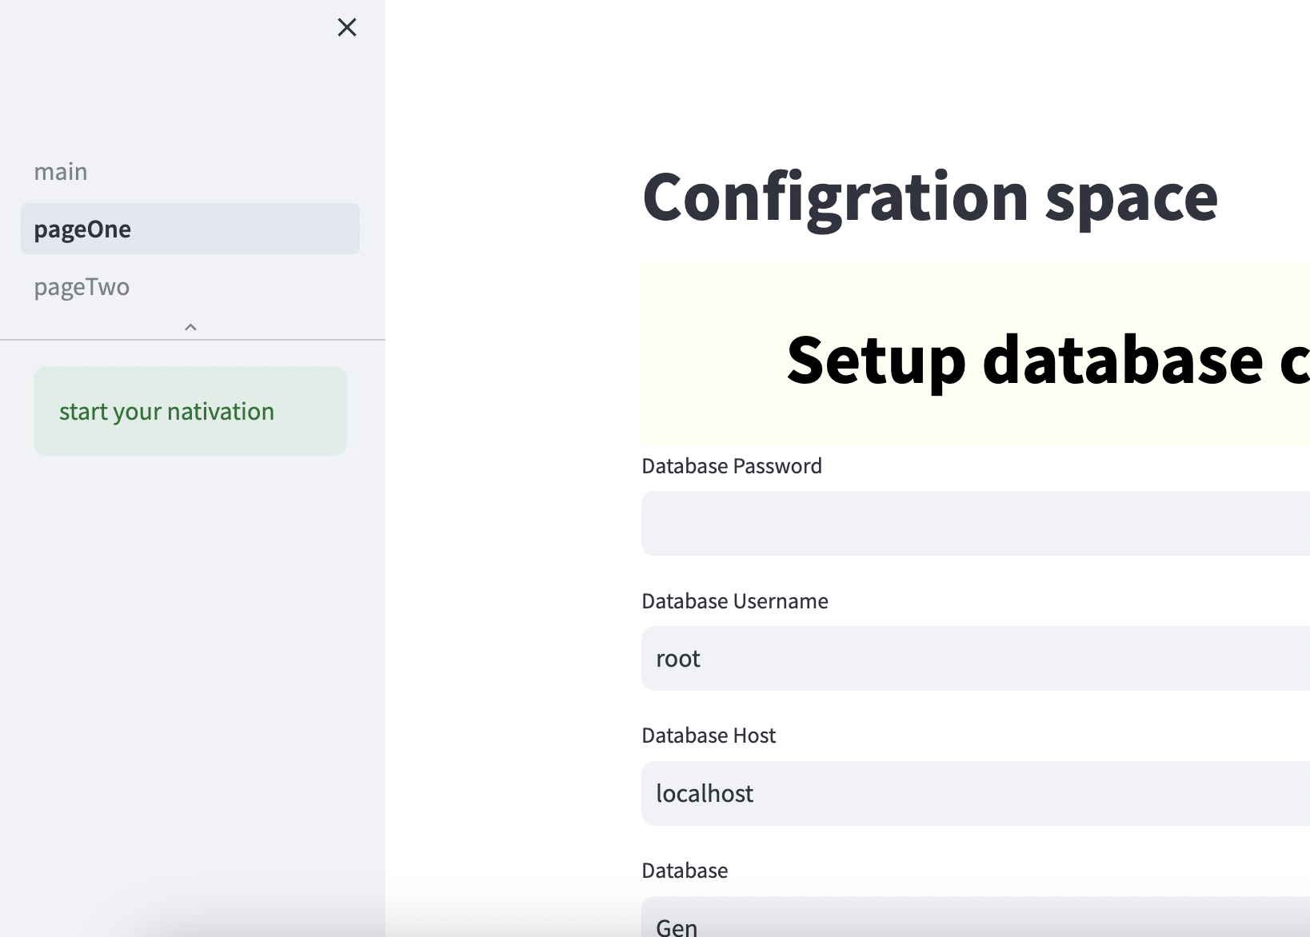
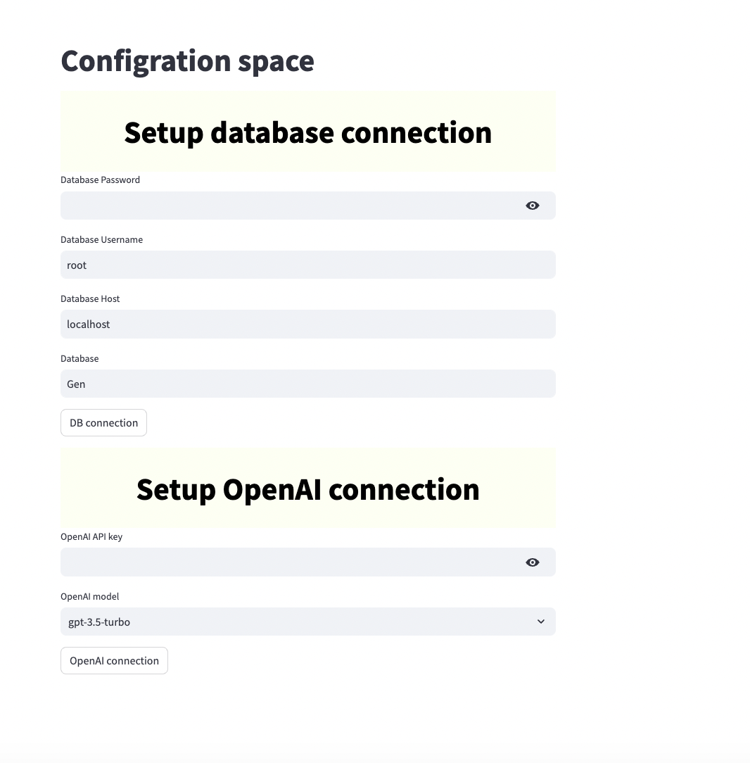
Connection setup for Database and OpenAI APIs
Two Connections
MySQL database
Tested the connection
Once the test is passed if will be used for page two
Dynamically store the connection and password
OpenAI API
Dynamically Stored the connection parameters after testing

Slide 3

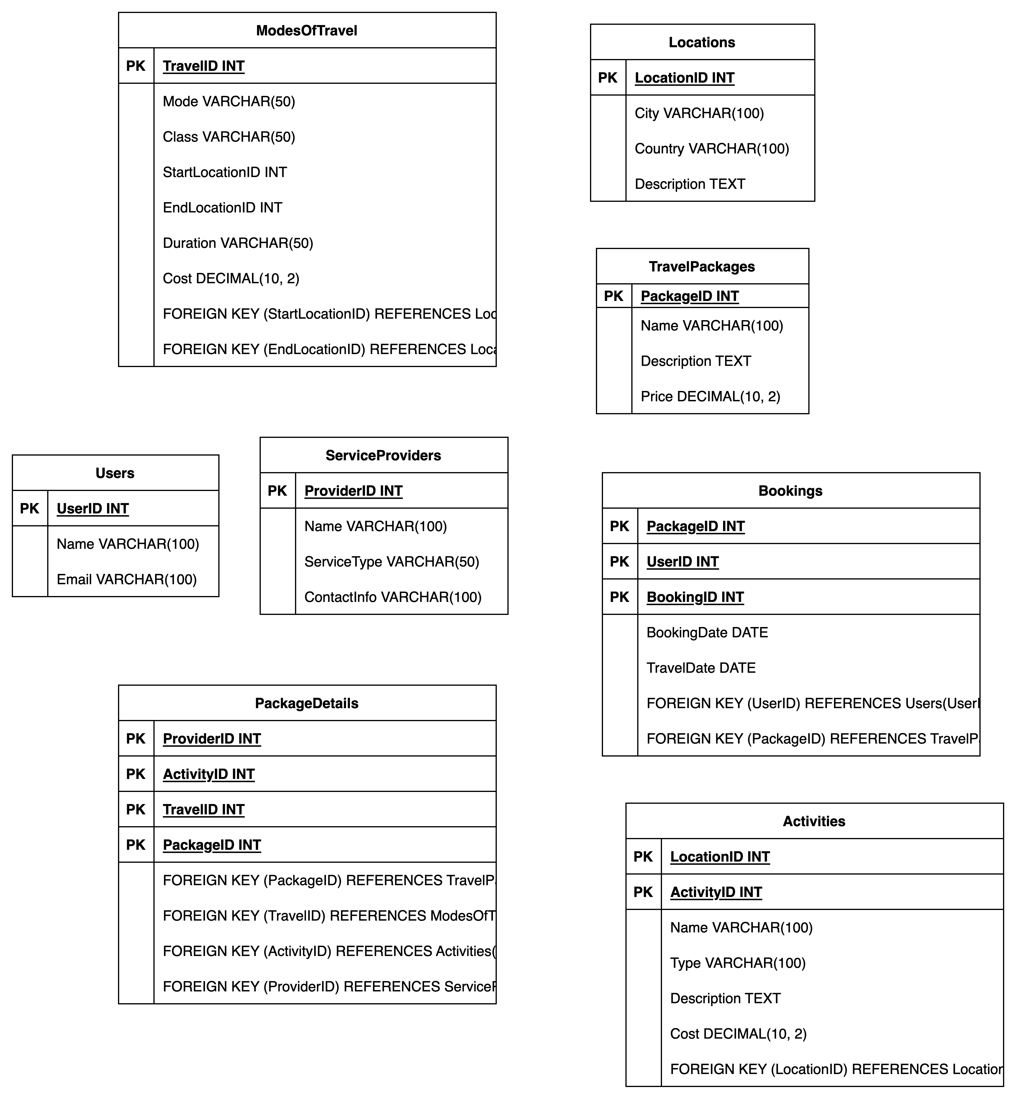
Database
1. Locations Table: Stores information about various travel destinations.
2. ModesOfTravel Table: Details the different modes of travel between locations.
3. Activities Table: Lists activities available at each location.
4. ServiceProviders Table: Information about companies and individuals offering services related to travel.
5. TravelPackages Table: Details of pre-arranged travel packages.
6. PackageDetails Table: Connects travel packages with specific modes of travel, activities, and service providers.
7. Users Table: Stores information about users of the service.
8. Bookings Table: Records of bookings made by users.
Relationships:
the PackageDetails table acts as a junction table, connecting TravelPackages with ModesOfTravel, Activities, and ServiceProviders.
The Bookings table links Users to their chosen TravelPackages, offering insights into customer preferences and package popularity.

Slide 4
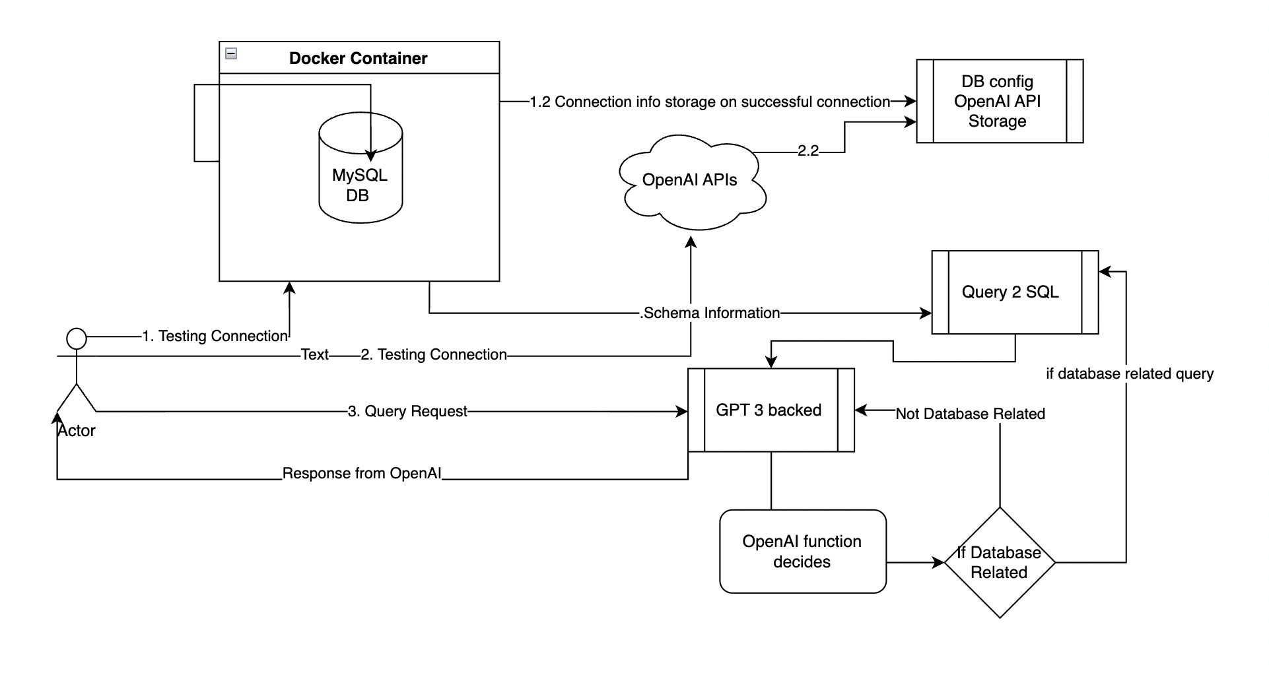
Code Flow

Slide 5
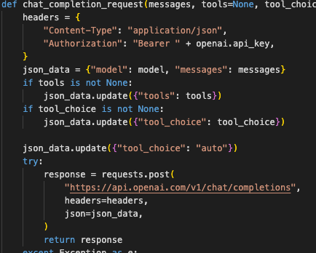
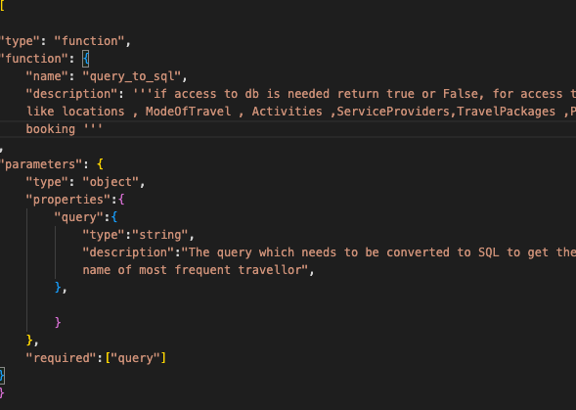
OpenAI API – tools (for source of information) inbuild tool in the API call is used to decide which way to go in the API call itself

Slide 6
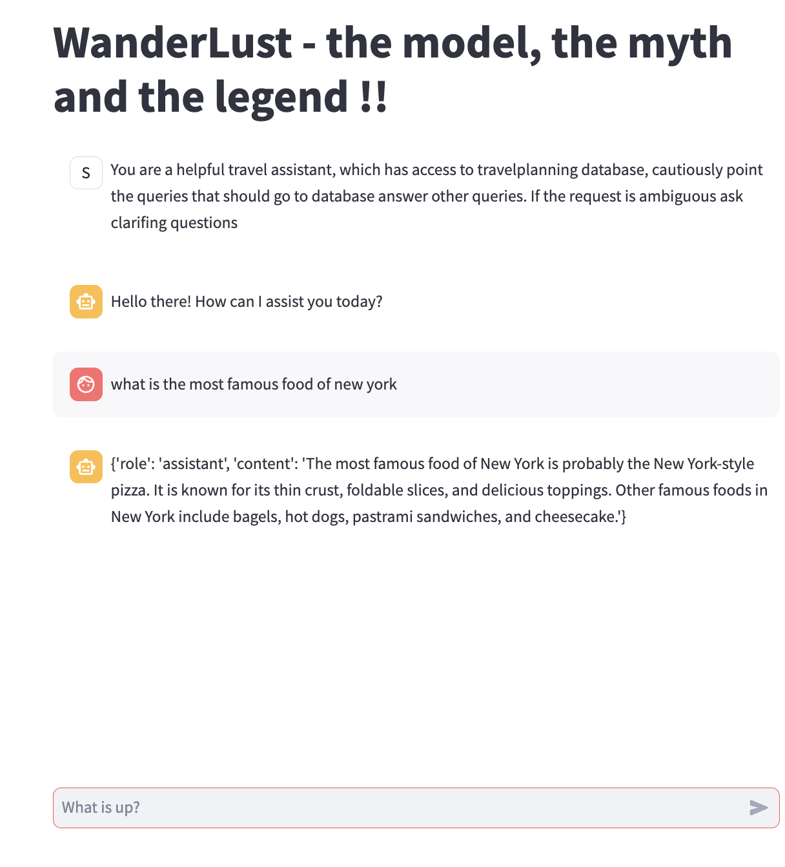
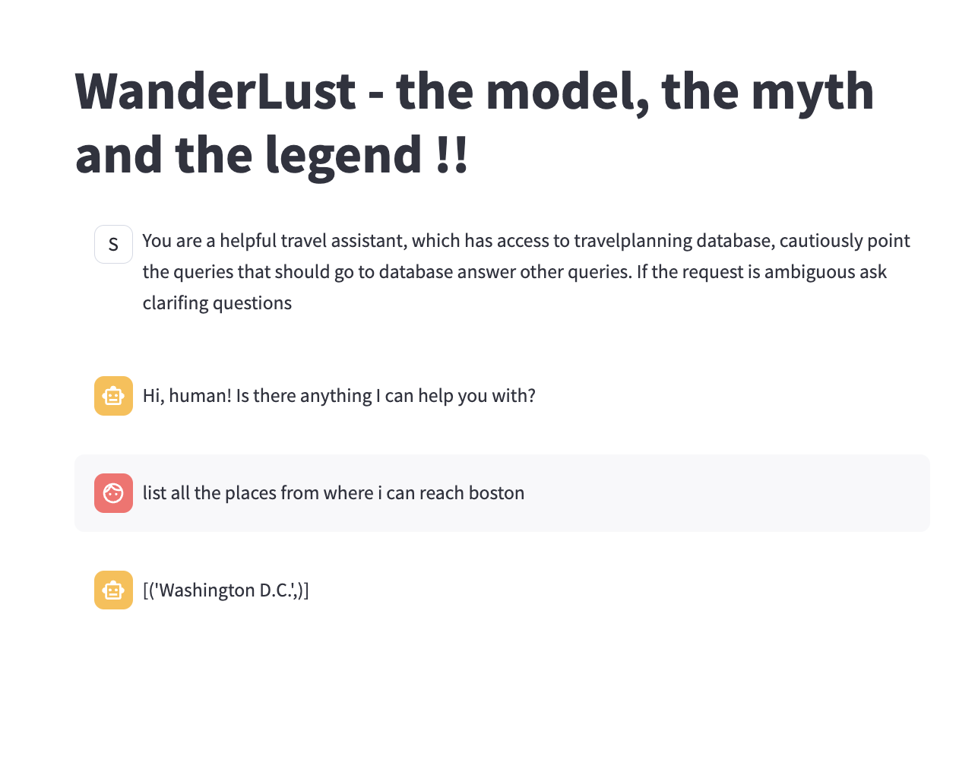
Results

